Slide 1


master modeler
Team Gradient Descent

Slide 2



Team Gradient Descent
Mansi Arora
MS Analytics
Jeh Lokhande
MS Analytics
Nabila Usmani
MS Analytics

Slide 3
Motivation

Slide 4


Slide 5
300,000,000

Slide 6
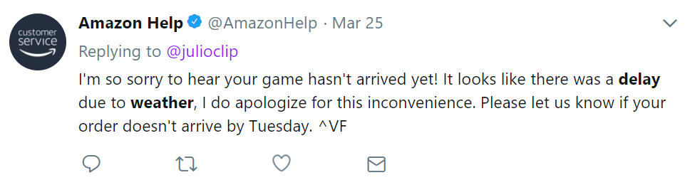
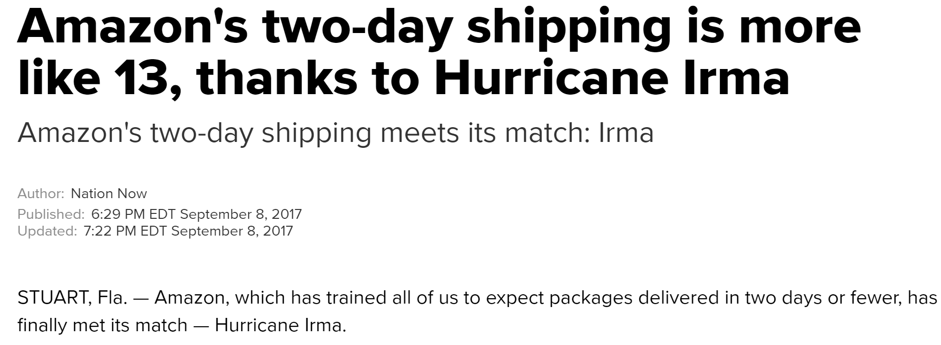
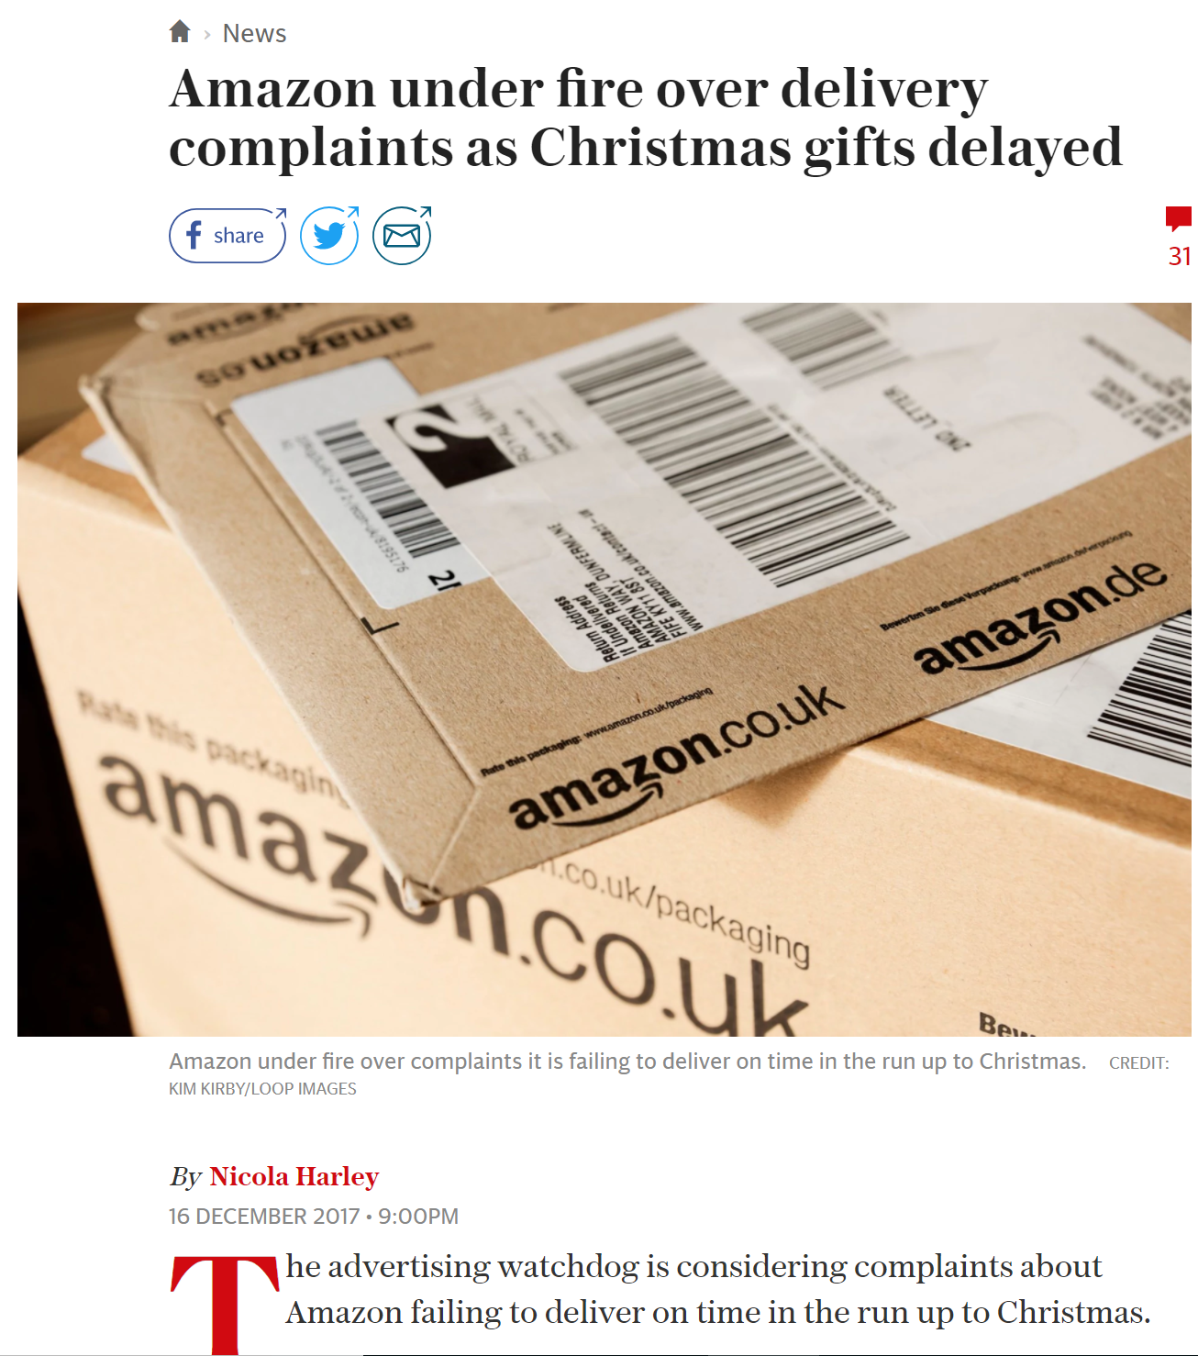
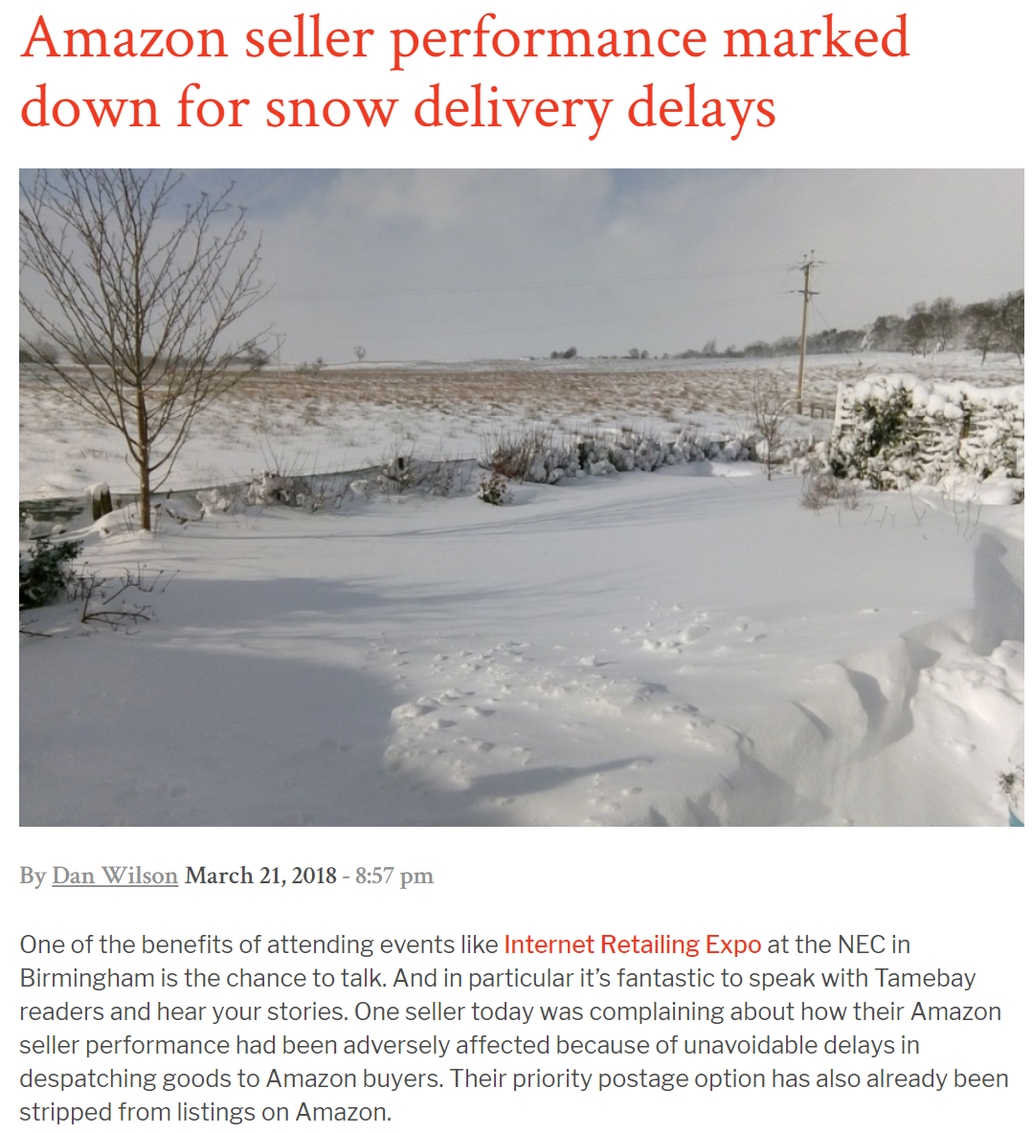

Slide 7
Objective
&
Scope

Slide 8
Prediction of delivery delays
Notes:
To take pre emptive measures and keep customers informed of potential delays

Slide 9
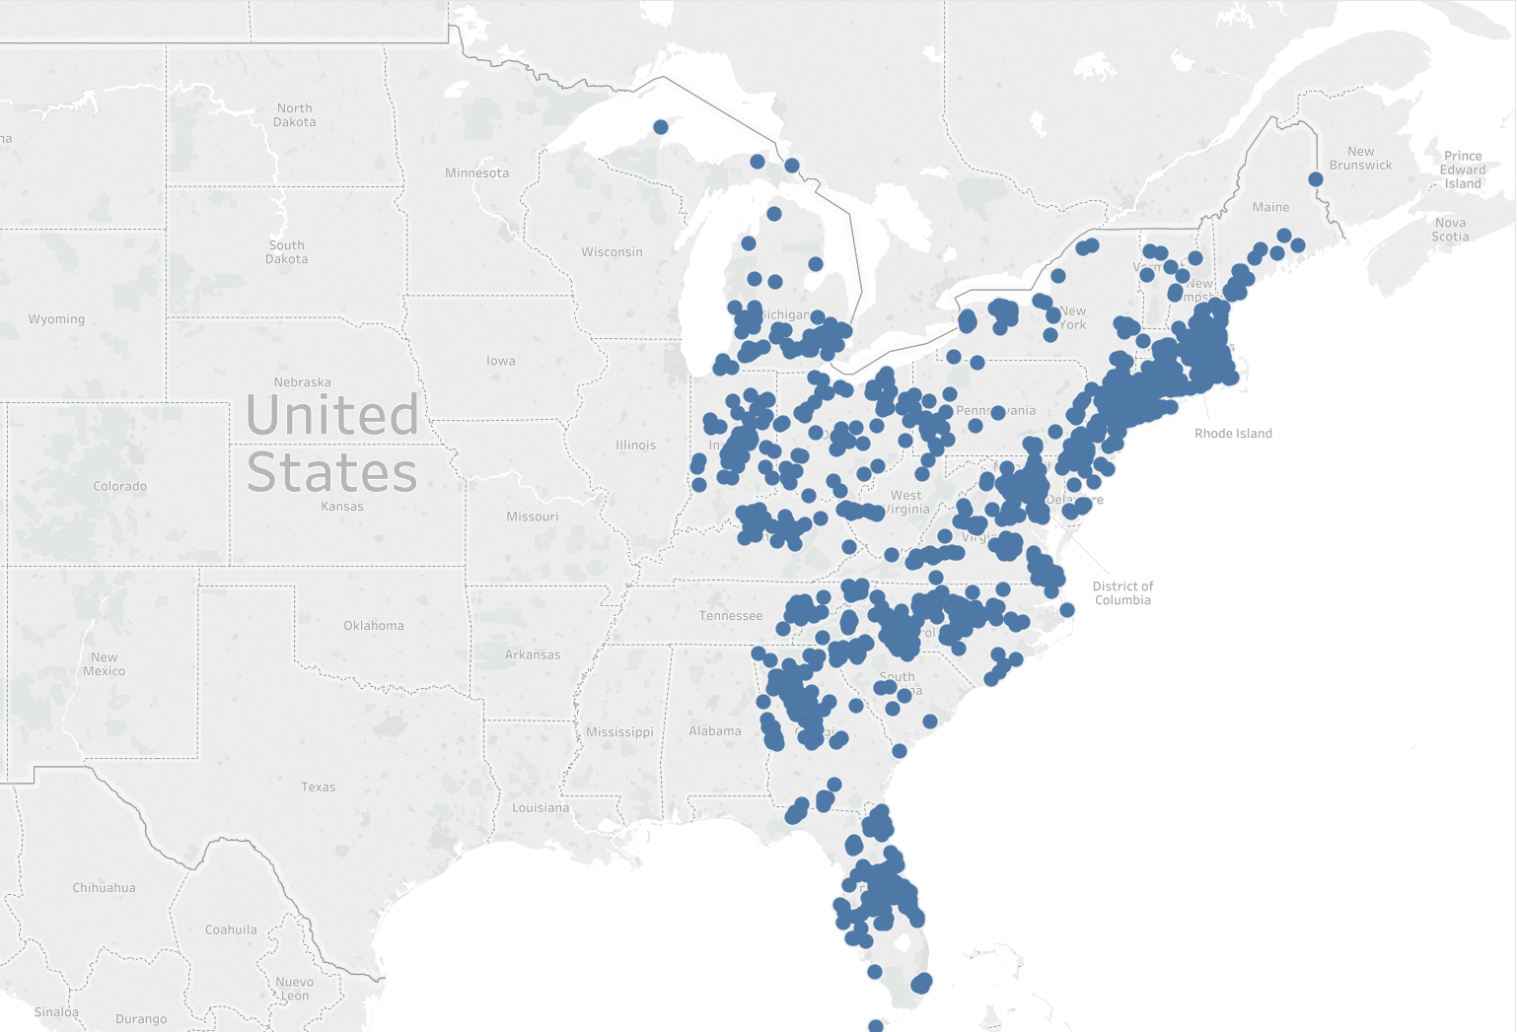
1500
ZIP Codes

Slide 10
Data

Slide 11







What can impact delays?
Weather
Holidays
Temporal attributes

Slide 12
Data
Weather - National Oceanic and Atmospheric Administration
Actual and forecast data for 19 weather attributes
Daily forecasts 10-72 hours in the future
Zip Code Level Data - US Census Bureau
Population
Urban - Rural score
Impact Score - Continuous and Binary

Slide 13
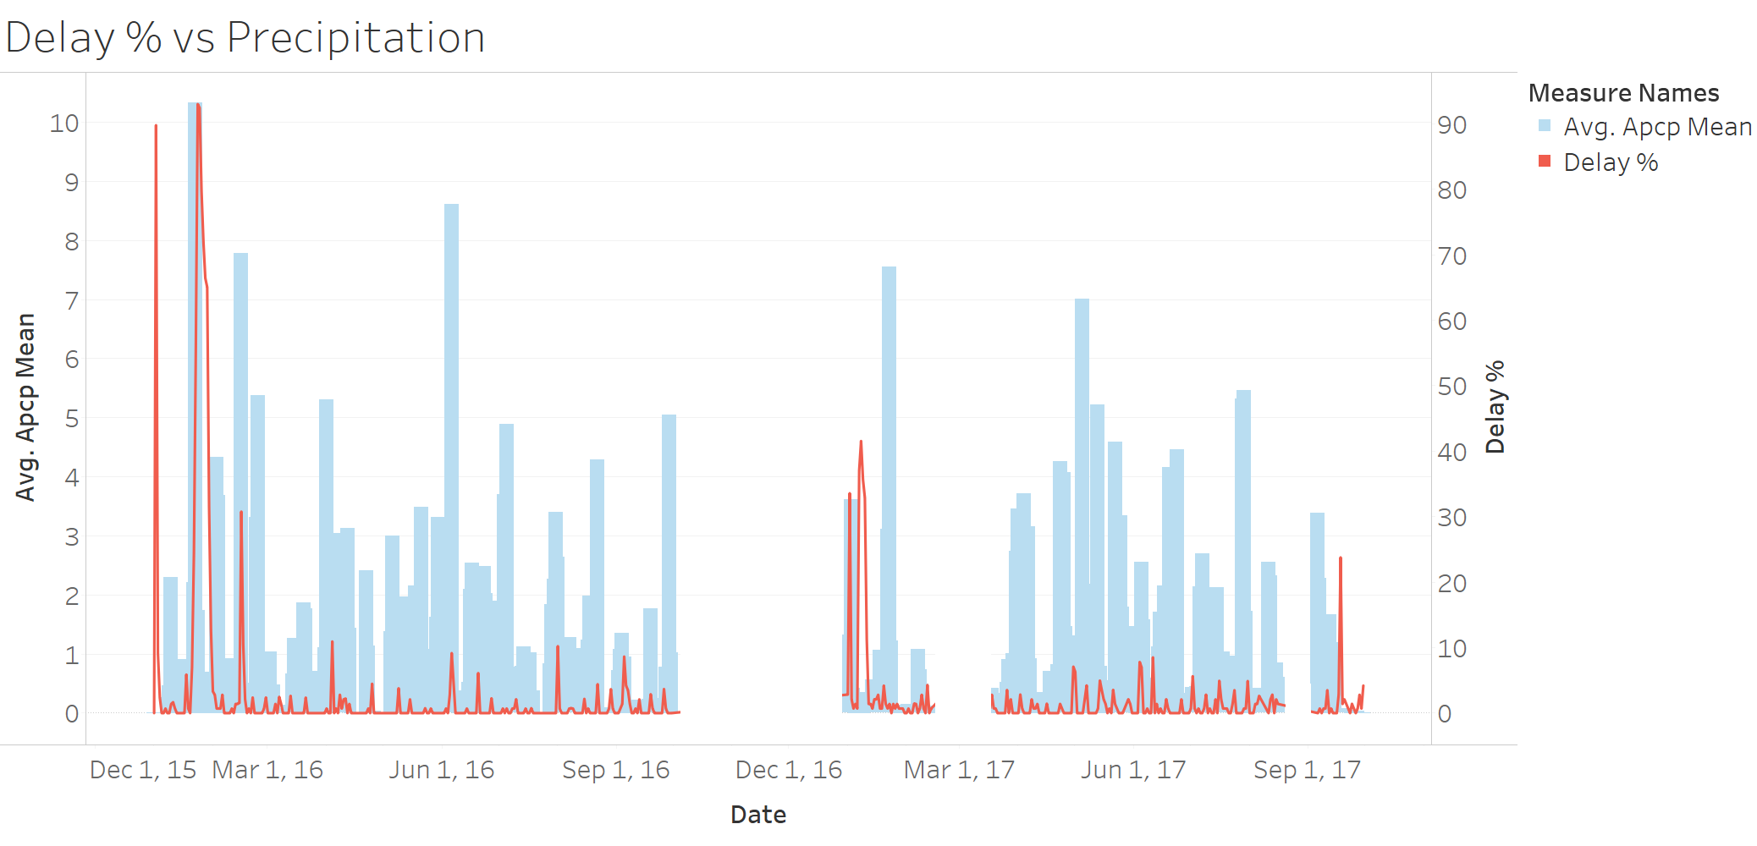
Data challenges - missing data

Slide 14
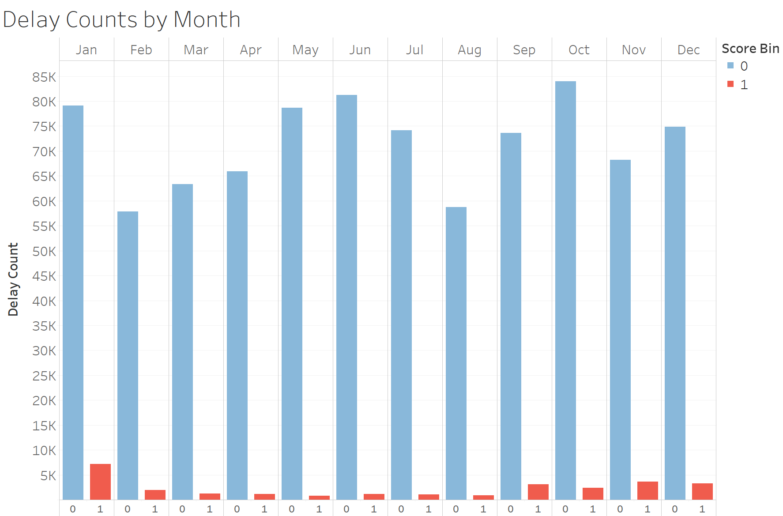
Data challenges - sparsity
Only 3.2% of data points are flagged as delays

Slide 15
Data challenges - size
~40 GB

Slide 16
Approach

Slide 17
Clustering
Cluster level exploratory analysis
Model development

Slide 18
Why Clustering?
Clustering
ZIP code level model
Ideal, captures unique ZIP code features
data is sparse
hard to capture seasonality with sparse data
43,000 ZIP codes in the US - tough to scale
Single model for all ZIP-codes
doesn’t capture zip code level variation
Solution: cluster similar ZIP codes together
similar: weather attributes, relation with impact scores
Notes:
Ideally, the models developed should be at a zip code level to capture the unique features of the zipcode such as transportation connectivity, sensitivity to weather events, etc. However, the data for delays (postive binary scores) is very sparse at a zipcode level. The number of delays also has potential seasonal patterns that are hard to capture with sparse data. An additional consideration is also that there are about 43,000 zip codes in the US, and 1423 zip codes in our data, so having a unique model for each zip code does not lend well to scalability of the models.
As a means to combat the above issues, clustering of similar zip codes is performed. Here similarity is defined as being geographically close, having similar weather attributes as well as having similar correlation between weather and impact scores. In short, we are clustering zip codes that react similarly to weather conditions and that have similar climatic conditions.

Slide 19
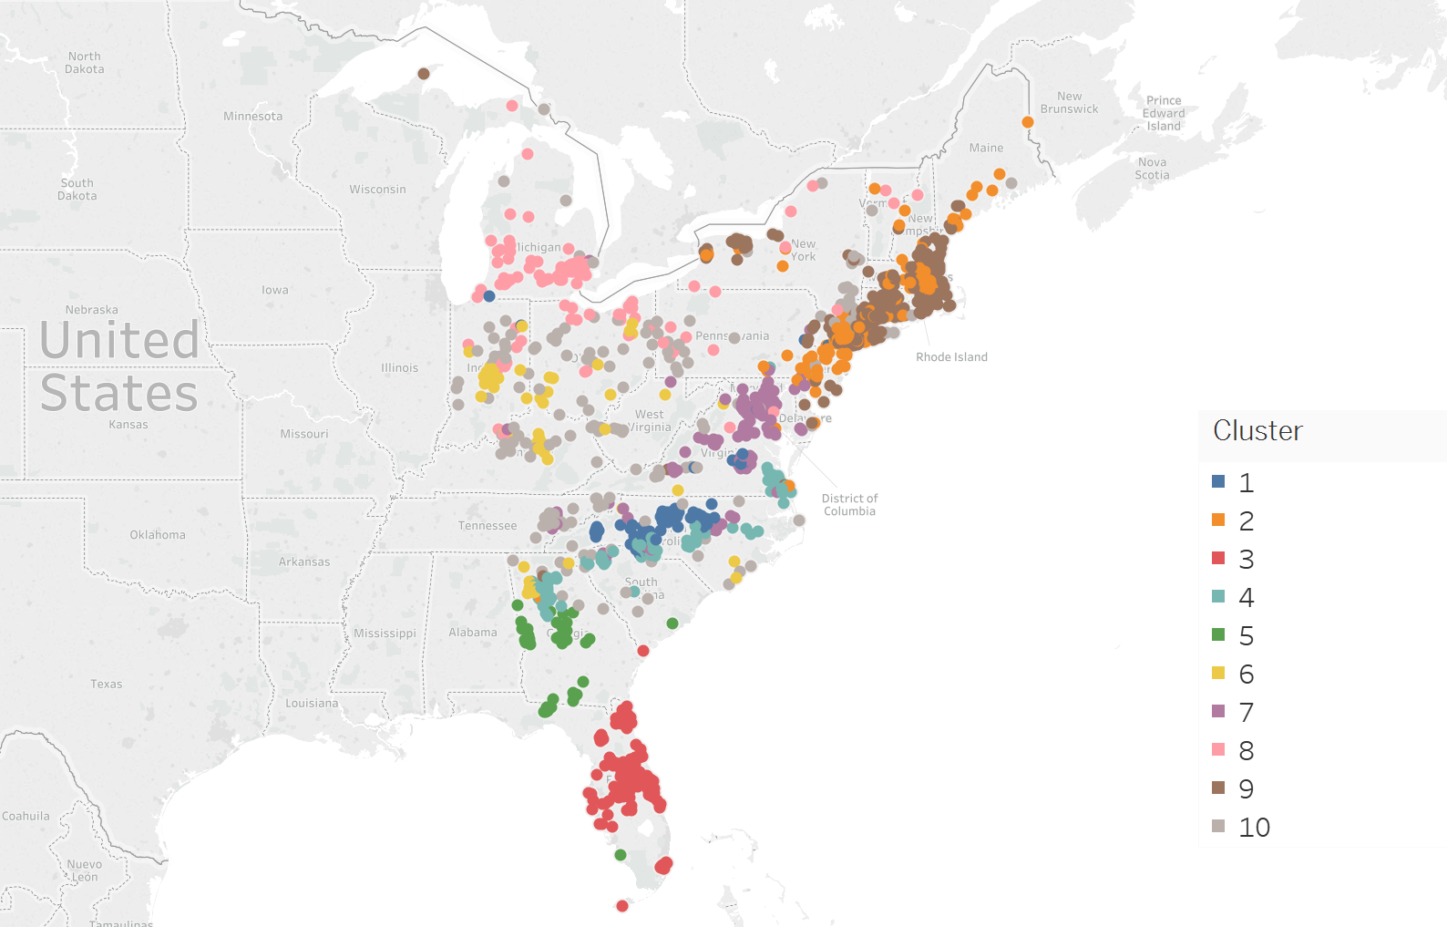
Clusters
Clustering

Slide 20
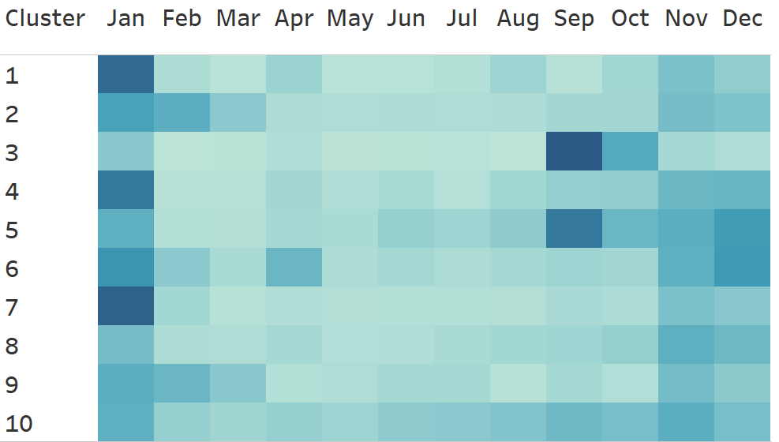
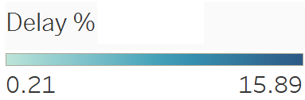
Delay distribution by Month
Cluster level analysis

Slide 21
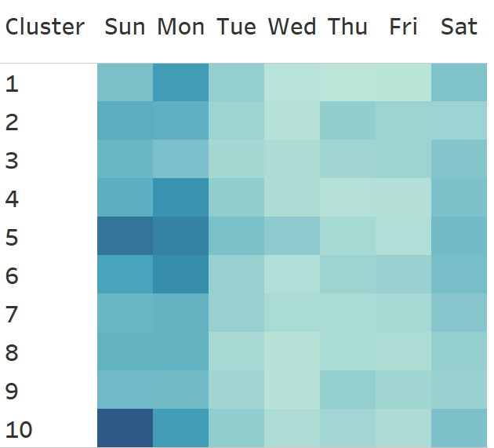
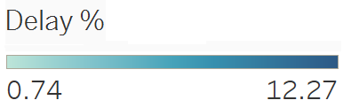
Delay distribution by Day of Week
Cluster level analysis

Slide 22
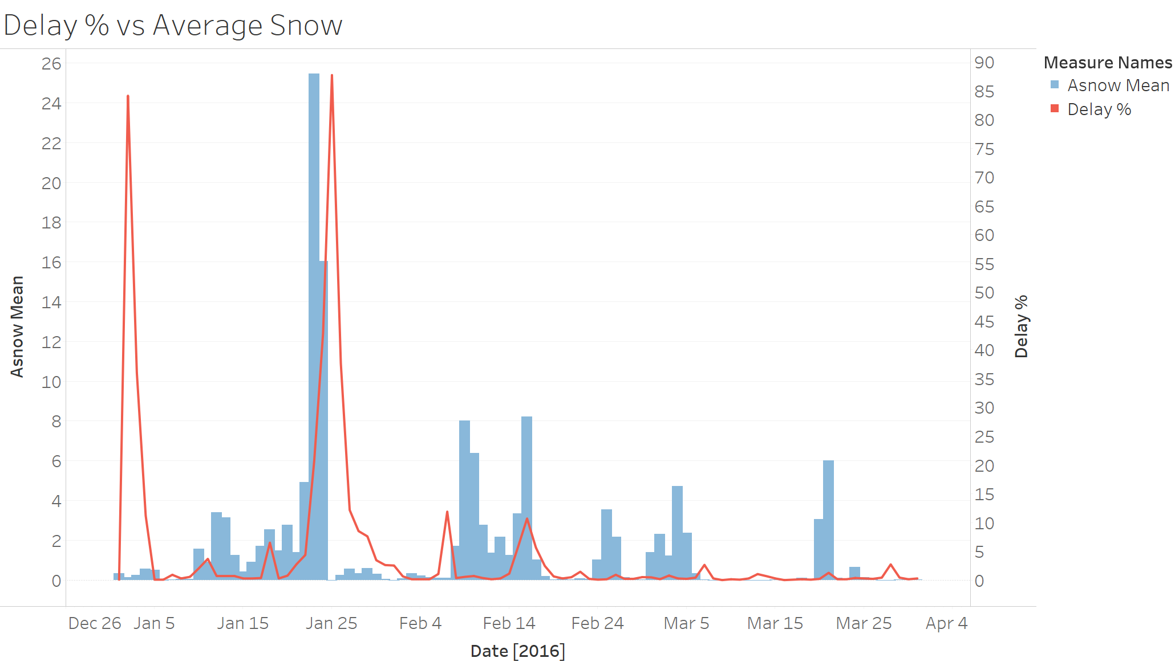
Feature Engineering
Model development
Lagged snow impact on delays

Slide 23
Feature Engineering
Model development
Daily, monthly and seasonal variables
Holiday variables

Slide 24



Classification Algorithm
Model development
Fast
Scalable
Predictive

Slide 25
XGBoost
Model development
Highly Parallelized
GPU / CPU
Short training time
Separate models for zip-code clusters
Parameter tuning
Imbalanced learning
Fast
Scalable
Predictive

Slide 26
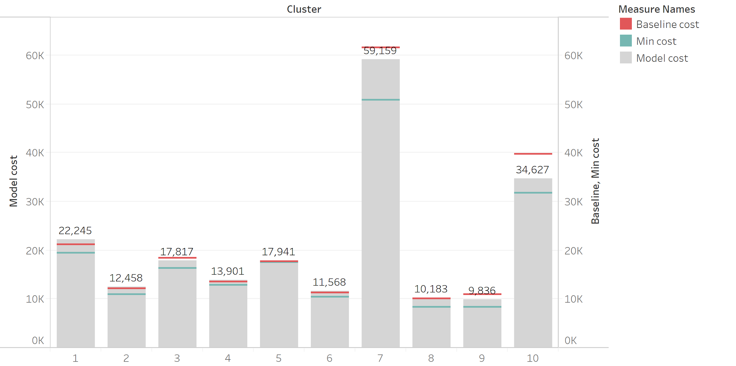
Results
Model development

Slide 27
Next steps

Slide 28
How we see this in production?
Relational Database
Modeling
Output
XGB Model
Trained every evening
XGB Model
Generate predictions for zip codes every morning
Incoming Weather Data
Weather Database
Generate outputs for Zonal Managers

Slide 29
Improvements envisioned
Change clusters on-line - Improved accuracy
Add flags for highly sparse variables such as tornado, weather warnings - out of model prediction

Slide 30

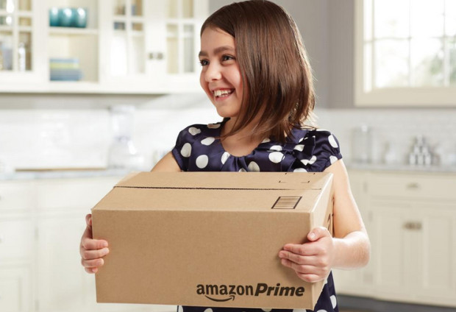
Questions?

Slide 31
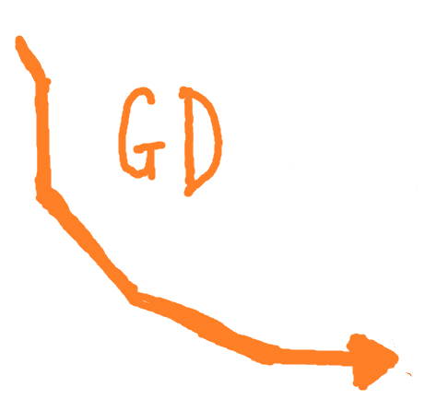

Thank You

